Slide 1

Phishing Awareness Training (Think Before, You Click)
Intern Name: Ayan Shahid
Email: ayanshahid0295@gmail.com

Slide 2
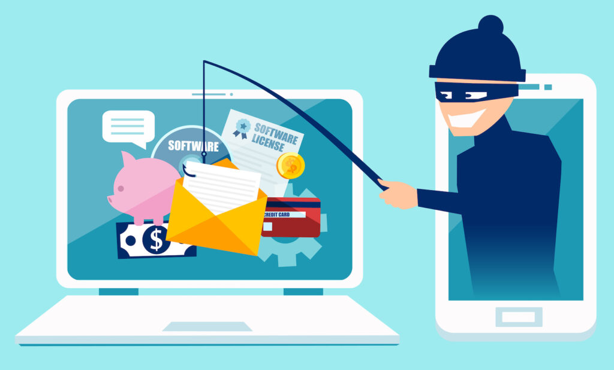
What is Phishing?
Phishing is a cyber attack where attackers trick users into revealing sensitive information.
Common targets: usernames, passwords, credit card info.
Attackers send emails that appear to come from legitimate sources (banks, colleagues, etc.)
Victims are prompted to click malicious links or download harmful attachments.

Slide 3
Common Types of Phishing Attacks
Email phishing
Spear phishing (targeted)
Whaling (targeting executives)
SMS phishing (Smishing)
Voice phishing (Vishing)

Slide 4
Recognizing Email Phishing
Look for suspicious sender addresses
Urgent or threatening language
Unexpected attachments or links
Example: fake bank email

Slide 5
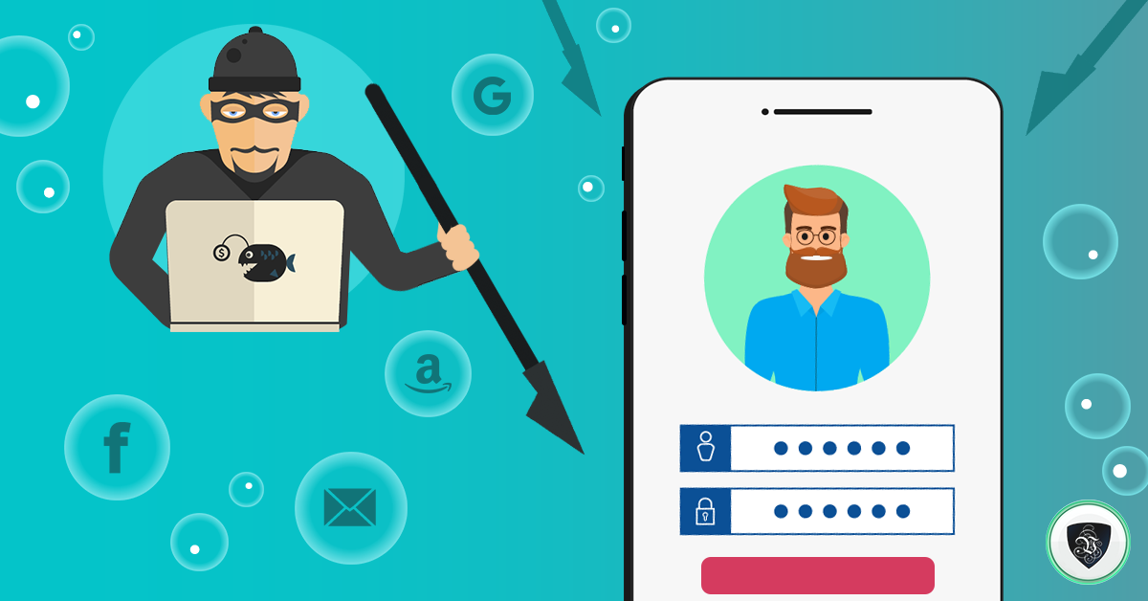
What is Spear Phishing?
A targeted attack where hackers create personalized emails that look real, tricking victims into sharing passwords, financial info, or installing malware, often by impersonating trusted people.

Slide 6
Whaling (targeting executives)
High-level targets like CEOs or CFOs
Emails appear from trusted business partners
Example: fake invoice request

Slide 7
SMS Phishing (Smishing)
Messages asking to click links or confirm info
Often claims to be banks, delivery services
Example: “Your package is on hold, click here”

Slide 8
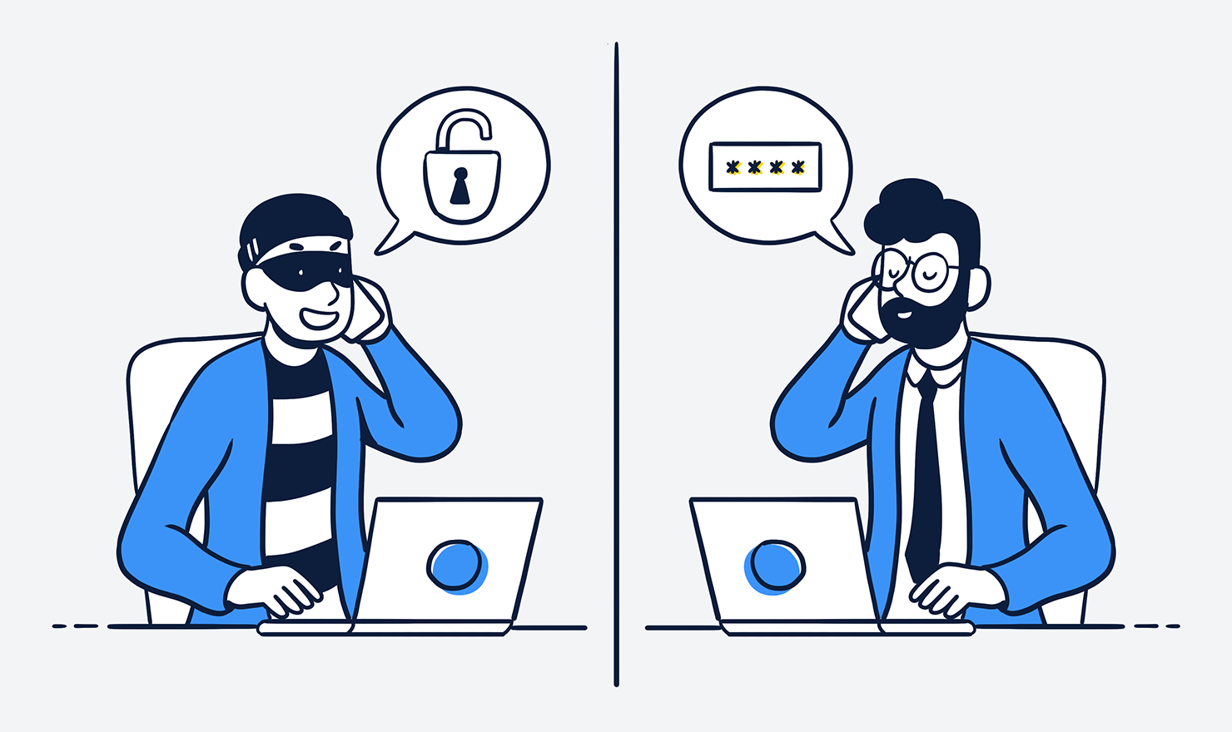
Voice Phishing (Vishing)
Caller pretends to be a bank or IT support
Asks for passwords or OTPs
Example: “We noticed suspicious activity on your account”

Slide 9
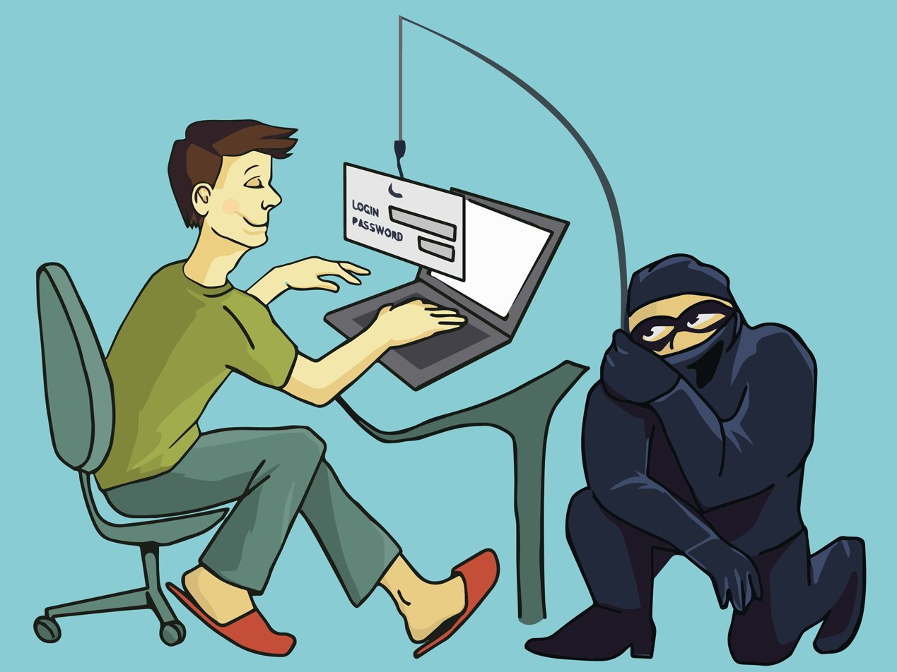
Social Engineering
Social engineering is manipulating people psychologically to trick them into giving up confidential information, granting unauthorized access, or performing actions that compromise security, relying on human behavior rather than technical hacking.

Slide 10
How Attackers Manipulate You
Exploiting trust, fear, curiosity
Common tactics: urgency, authority, reward
Example: “Click this to claim your prize!”

Slide 11

Key Components of Phishing Emails
Fake sender address
Urgent message
Suspicious links or attachments
Grammar mistakes

Slide 12

How to Identify Phishing Websites
Check URL spelling
Look for HTTPS and padlock
Avoid shortened URLs
Example: fake banking login page

Slide 13
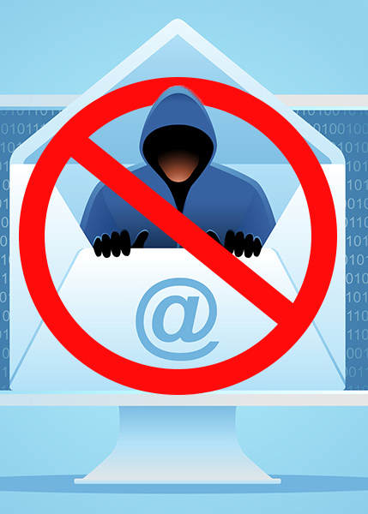
Attachment Safety
Avoid opening .exe, .zip, .scr files
Scan attachments with antivirus
Use sandbox environments for unknown files

Slide 14
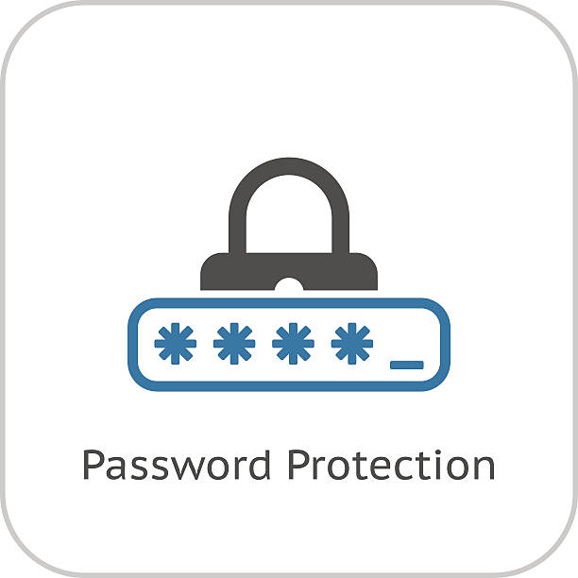
Password Protection
Use strong, unique passwords
Enable multi-factor authentication (MFA)
Never share passwords via email or SMS

Slide 15
Example 1: AI-Powered Real Estate Scam (Australia, 2025)
Attackers pretended to be real estate agents.
Victims were tricked into redirecting settlement payments to fraud accounts.
Loss: A couple lost ~AU$250,000.
Lesson: Always verify payment instructions with trusted contacts.

Slide 16
Example 2: Fake Google Email Phishing (2025)
Attackers sent emails pretending to be Google, tricking users into clicking links.
Links led to fake Microsoft 365 login pages capturing credentials.
Impact: Users risked losing access to emails and sensitive data.
Lesson: Always check sender address and hover over links before clicking.

Slide 17
Current Phishing Trends
COVID-19 and health-related scams
Fake cryptocurrency offers
Business email compromise (BEC)

Slide 18
Protective Measures
Keep software updated
Use antivirus and firewall
Don’t click unknown links
Backup data regularly
Don’t share credentials
Report incidents promptly

Slide 19
Personal Safety Tips
Don’t trust unsolicited emails
Verify URLs before logging in
Use password managers for strong passwords
Keep devices secure

Slide 20
Conclusion
Phishing attack is common, evolving, and targets everyone.
Always verify emails, links, and attachments before taking any action.
Use strong passwords and multi-factor authentication (MFA) for extra security.
Report suspicious emails to your IT or security team immediately.
Stay informed about real-world phishing attacks to recognize new tactics.

Slide 21

THE END

